Slide 1
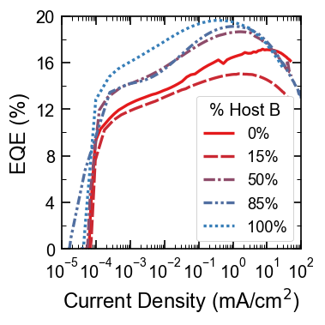
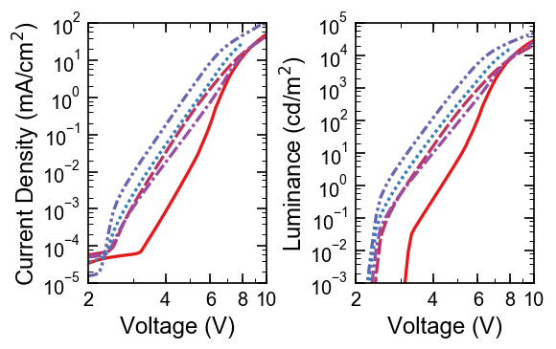
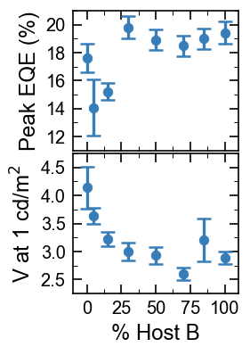
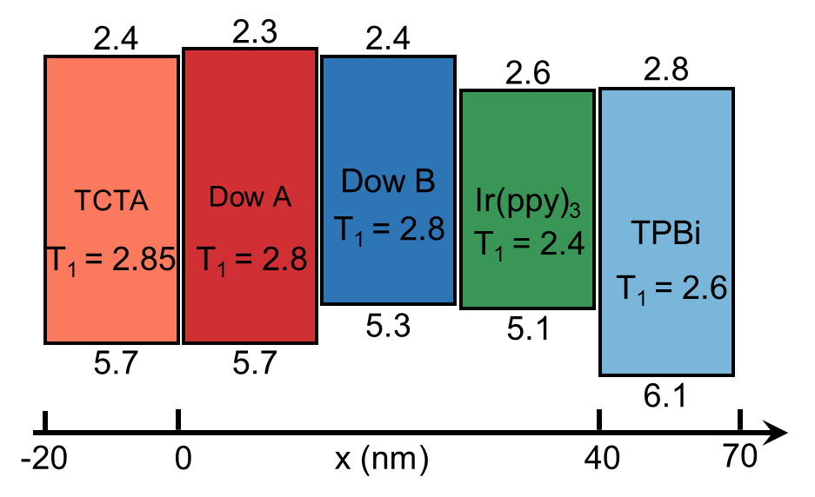
Efficiency, lifetime, and energy levels
Figure 1. Efficiency and Energy Levels
a
c
d
b
e

Slide 2
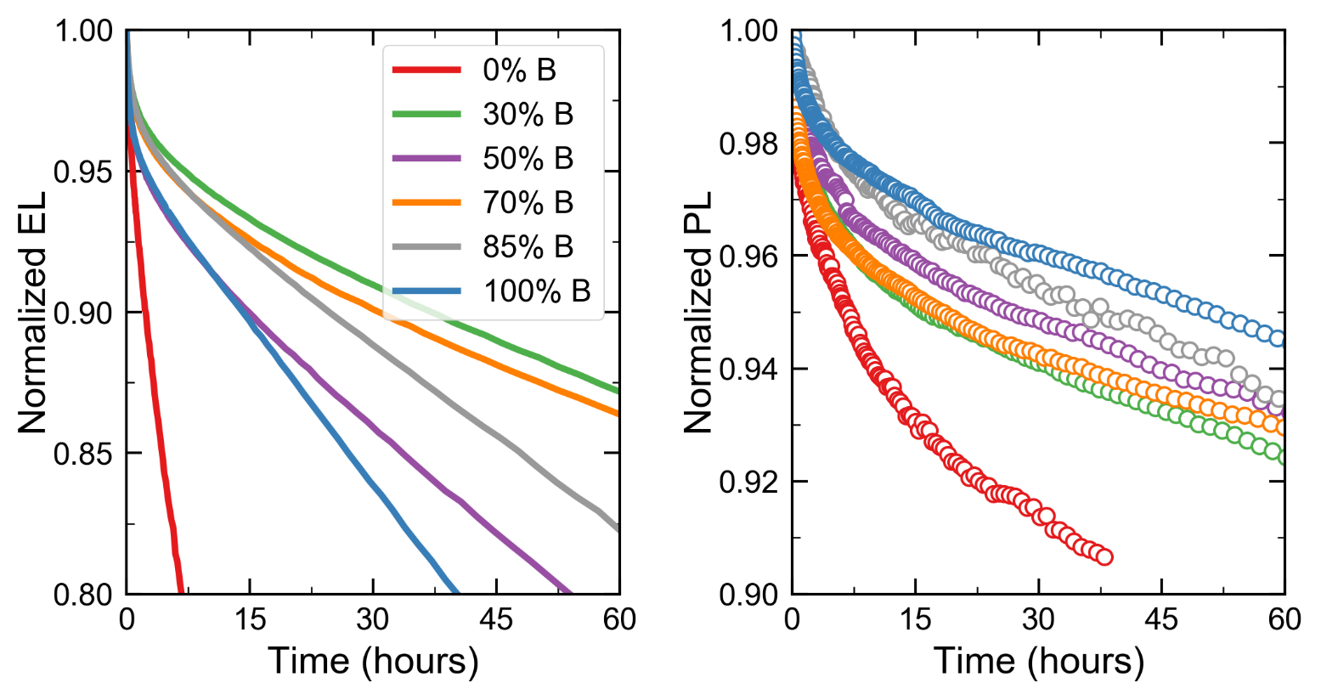
Figure 2. 10 nm EML Lifetimes
(a)
(b)

Slide 3
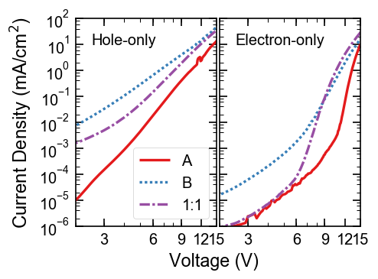
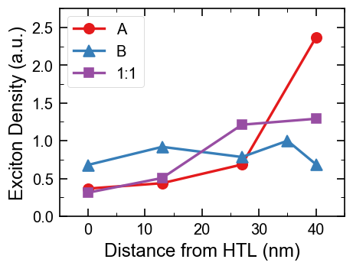
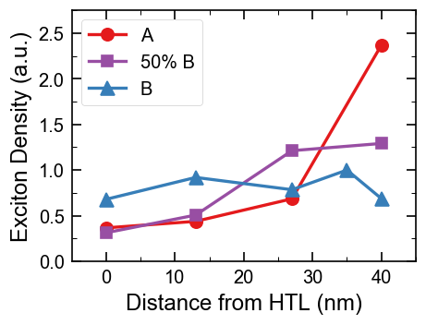
Figure 3. Single-carrier and RZ
a
c
Al 100 nm
MoOx 10 nm
TCTA 30 nm
Dow Hosts:Ir(ppy)₃ (15%) 100 nm
TCTA (30 nm)
ITO
b
d
LiF 1 nm/Al 100 nm
TPBi 30 nm
Dow Hosts:Ir(ppy)₃ (15%) 100 nm
TPBi (30 nm)
LiF 1 nm/Al 10 nm
ITO
Electron Only

Slide 4
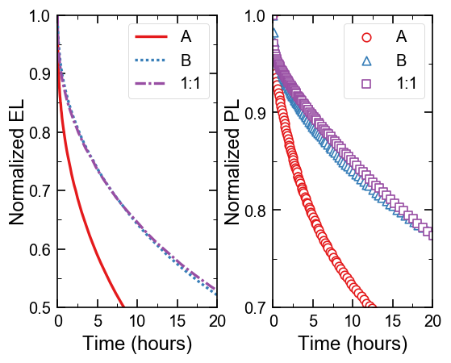
Figure 4. 10 nm EML Lifetimes
a
b

Slide 5
LiF + Al
TPBi 30 nm
Host:Ir(ppy)₃ (15%) 40 nm
TCTA 20 nm
2.3
AQ1250/ITO/Glass
2.4
2.4
TCTA
Dow A
Dow B
2.6
2.8
Ir(ppy)₃
TPBi
T₁ = 2.8
T₁ = 2.4
T₁ = 2.85
T₁ = 2.8
T₁ = 2.6
5.3
5.1
5.7
5.7
6.1
-20
0
x (nm)
40
70

Slide 6
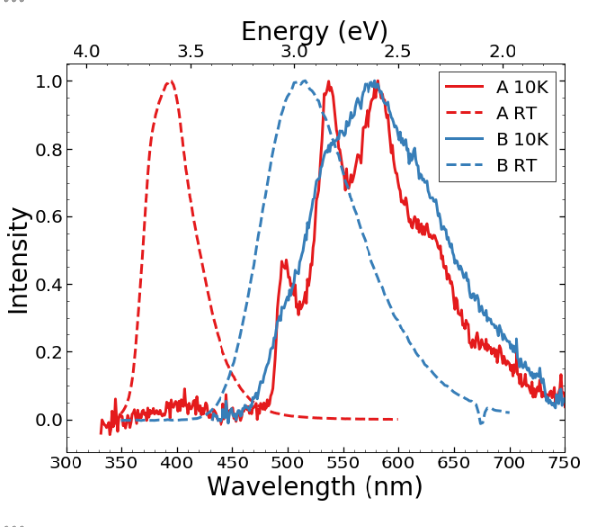
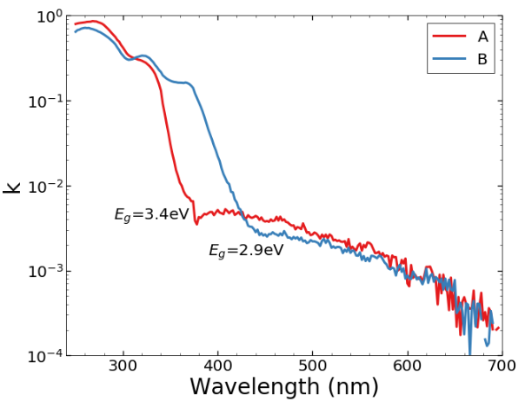
SI: Host properties
a
b

Slide 7
SI: RZ measurement spectra

Slide 8
SI: 10 nm M-EML Efficiencies

Slide 9
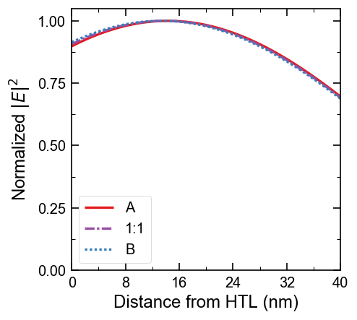
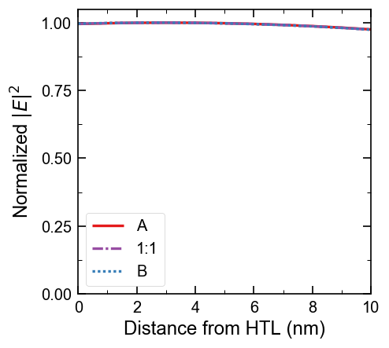
Electric field profiles

Slide 10
SI: 5% Ir(ppy)₃ Devices

